Slide 1

Chapter 4
INTEGRALS

Slide 2
Contents
4.1 Approximate Integration and Distance
4.2 The Define Integral
4.3 Evaluating Define Integrals
4.4 The Fundamental Theorem of Calculus

Slide 3

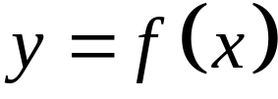


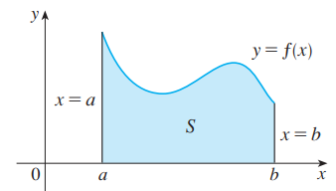
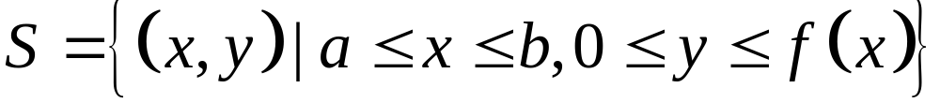
4.1 Approximate Integration and Distance
The area problem
Find the area of the region that lies under the curve
from to

Slide 4
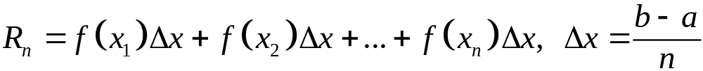
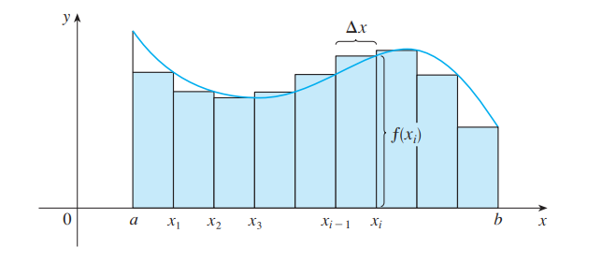
4.1 Approximate Integration and Distance
The area problem
What we think of intuitively as the area of S is approximated by the sum of the areas of these rectangles:

Slide 5
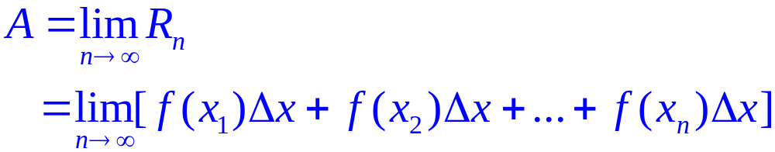
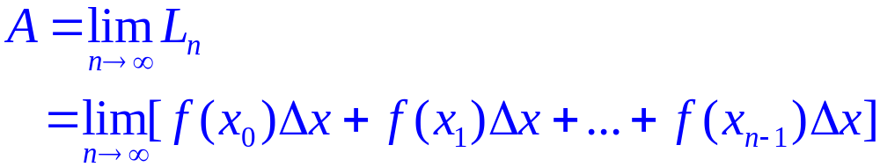
4.1 Approximate Integration and Distance
The area problem
Definition 1:
The figure shows approximating rectangles when the sample points are not chosen to be endpoints.

Slide 6
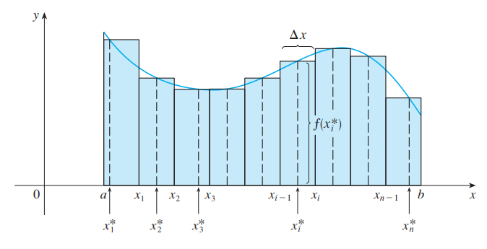
4.1 Approximate Integration and Distance
The area problem
Definition 2:
The area A of the region S that lies under the graph of the continuous function f is the limit of the sum of the areas of approximating rectangles:
x_{i}* in the i ^{th} subinterval [x_{i - 1}, x_{i}]
(the sample points)

Slide 7
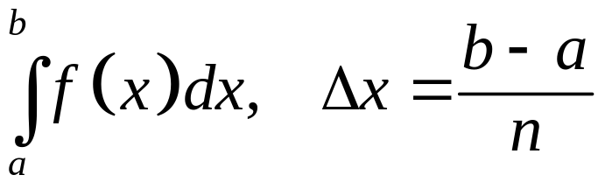
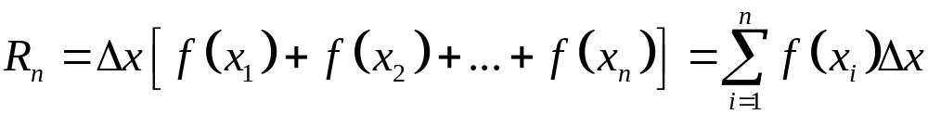
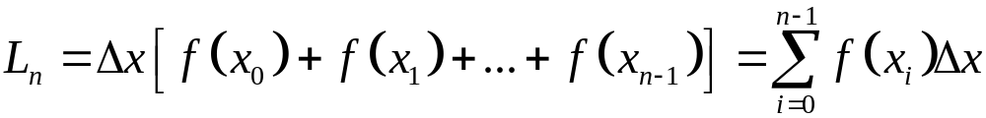
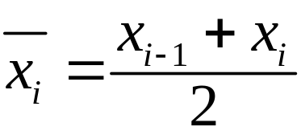
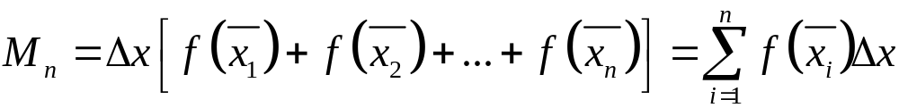
4.1 Approximate Integration and Distance
The left end point, right end point and midpoint
1/
2/
3/
Notes:
The sample point such as left end point, right end point and midpoint.

Slide 8
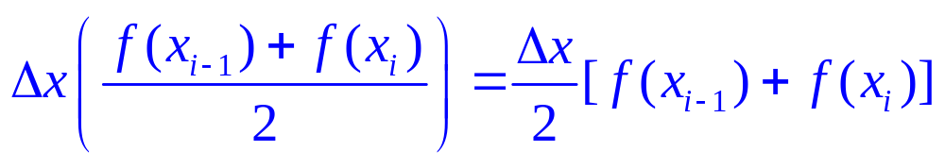
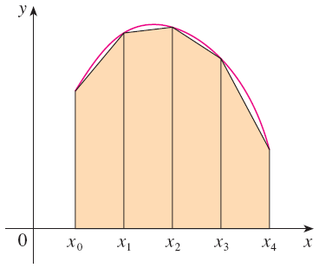
4.1 Approximate Integration and Distance
Trapezoidal rule
The reason for the name can be seen from the figure, which illustrates the case f(x) ≥ 0. The area of the trapezoid that lies above the i th subinterval is:
  If we add the areas of
  all these trapezoids,
  we get the right side of
  the Trapezoidal Rule.

Slide 9
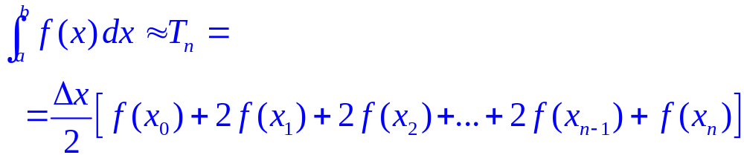
4.1 Approximate Integration and Distance
Trapezoidal rule
where ∆x = (b – a)/n and x_{i} = a + i ∆x.

Slide 10
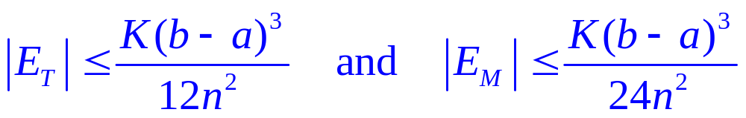
4.1 Approximate Integration and Distance
Error bounds
Suppose | f’’(x) | ≤ K for a ≤ x ≤ b. If E_{T} and E_{M} are the
errors in the Trapezoidal and Midpoint Rules, then

Slide 11
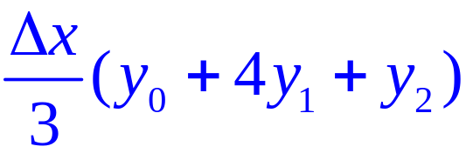
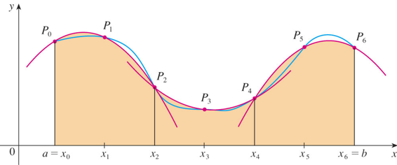
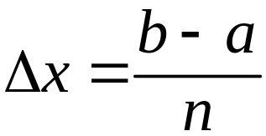
4.1 Approximate Integration and Distance
Simpson’s rule: This is called Simpson’s Rule,after the English the English mathematician Thomas Simpson (1710–1761).
This means that the area under the parabola through P₀, P₁,
and P₂ from x = x₀ to x = x₂ is still:
where n is
even and

Slide 12
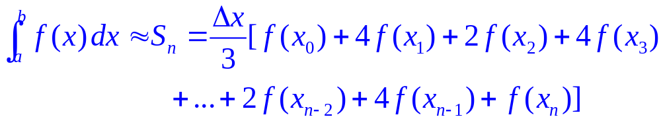
4.1 Approximate Integration and Distance
Simpson’s rule: This is called Simpson’s Rule,after the English the English mathematician Thomas Simpson (1710–1761).
where n is even and

Slide 13
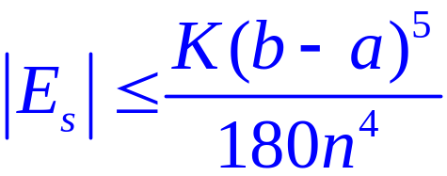
4.1 Approximate Integration and Distance
Simpson’s rule:
Suppose that | f ⁽⁴⁾(x) | ≤ K for a ≤ x ≤ b. If E_{s} is the error
involved in using Simpson’s Rule, then

Slide 14
4.1 Approximate Integration and Distance
Summary
1/
2/
3/
Notes:
The sample point such as left end point, right end point and midpoint.

Slide 15
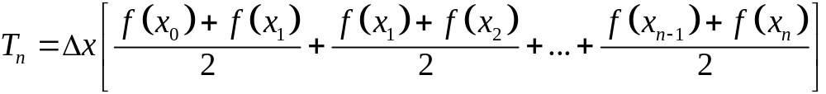
4.1 Approximate Integration and Distance
Summary
4/
Notes:
The sample point such as left end point, right end point and midpoint.

Slide 16
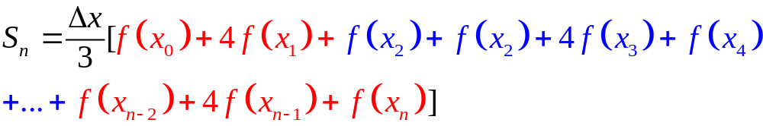
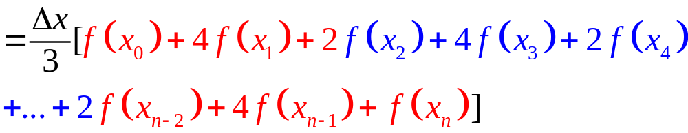
4.1 Approximate Integration and Distance
Summary
5/

Slide 17
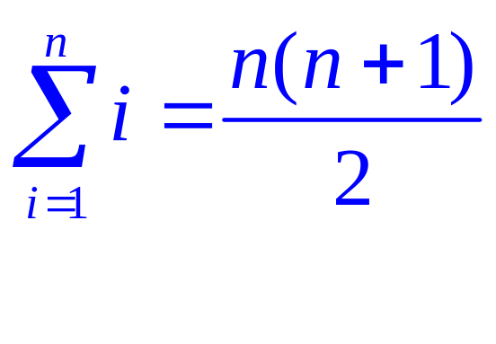
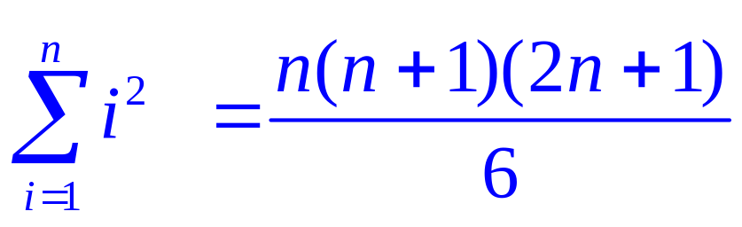
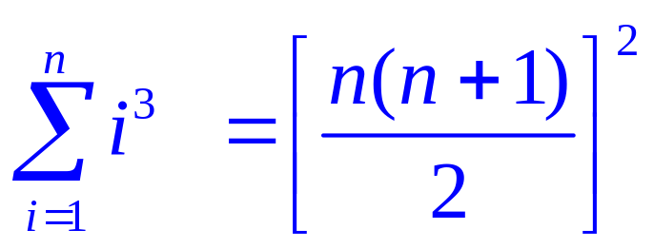
4.1 Approximate Integration and Distance
The following three equations give formulas for sums of powers of positive integers.

Slide 18
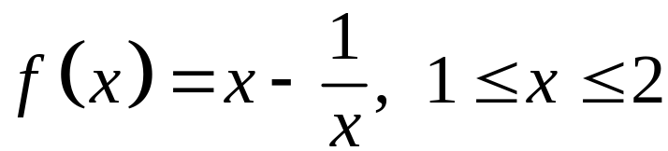
4.1 Approximate Integration and Distance
Example 1:
Evaluating the Riemann sum of the function
, with four subintervals.
a/ The sample points are the right endpoints.
b/ The sample points are the left endpoints.
Notes:
Ans: a/ 104/105=0,9905; b/ 517/840=0,6155

Slide 19
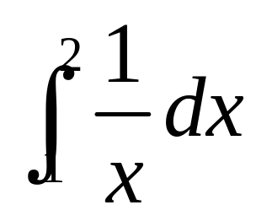
4.1 Approximate Integration and Distance
Example 2:
Let . Evaluate approximate the integral
a/ Use the Midpoint Rule with n = 5.
b/ Using the trapezoidal Rule with n = 5.
c/ Using the Simpson’s rule with n = 10.

Slide 20
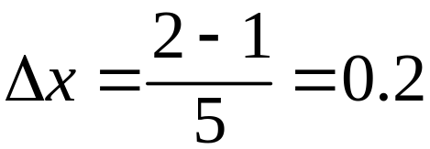
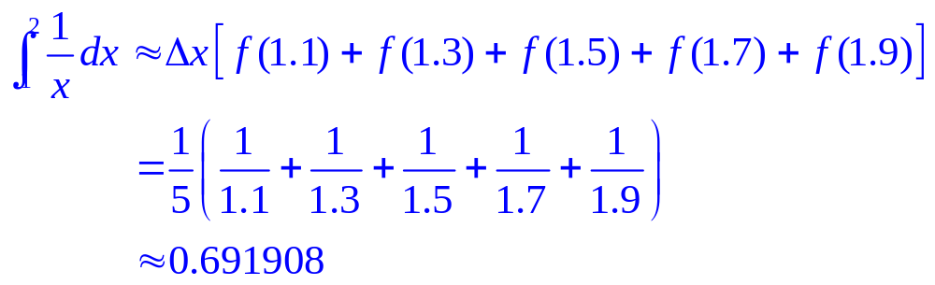
4.1 Approximate Integration and Distance
Solution:
a/ The width of the subintervals is:
The midpoints are: 1.1, 1.3, 1.5, 1.7, 1.9.
So, the Midpoint Rule gives:

Slide 21
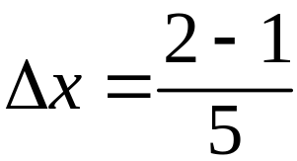
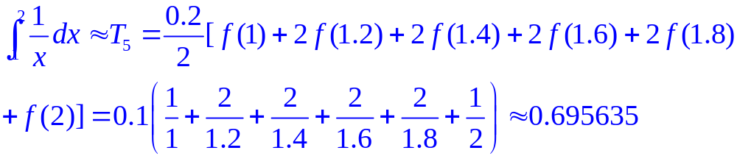
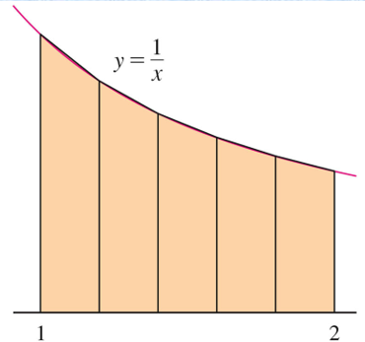
4.1 Approximate Integration and Distance
b/ With n = 5, a = 1 and b = 2, we have:
So, the Trapezoidal Rule gives:
The approximation is
illustrated here.

Slide 22
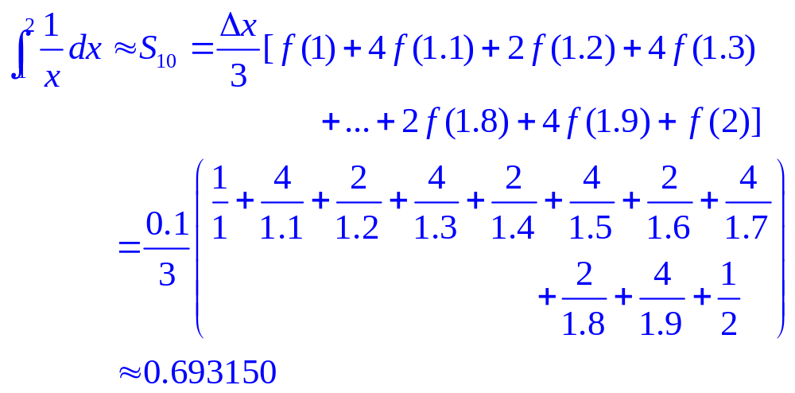
4.1 Approximate Integration and Distance
c/ Putting f (x) = 1/x, n = 10, and ∆x = 0.1 in Simpson’s Rule, we obtain:

Slide 23
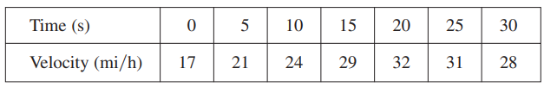
4.1 Approximate Integration and Distance
Distance problem
Suppose the odometer on our car is broken and we want to estimate the distance driven over a 30-second time interval.
We take speedometer readings every five seconds and record them in this table.
Notes:
Actual distance traveled by approximating the area under the velocity curve.

Slide 24
4.1 Approximate Integration and Distance
Distance problem
If we take the velocity during that time interval to be the initial velocity (25 ft/s), then we obtain the approximate distance traveled during the first five seconds:
25 ft/s x 5 s = 125 ft
If we had wanted a more accurate estimate, we could have taken velocity readings every two seconds, or even every second.
Notes:
Actual distance traveled by approximating the area under the velocity curve.

Slide 25
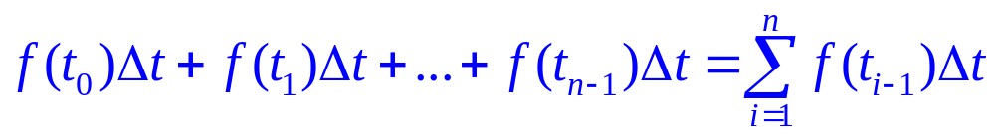
4.1 Approximate Integration and Distance
Distance problem
In general, suppose an object moves with velocity v = f(t) where a ≤ t ≤ b and f(t) ≥ 0.
We take velocity readings at times:t₀(= a), t₁, t₂, …., t_{n}(= b)
so that the velocity is approximately constant on each subinterval: ∆t = (b – a)/n.
Similarly, the distance traveled during the second time interval is about f(t₁)∆t and the total distance traveled during the time interval [a, b] is approximately
Notes:
Actual distance traveled by approximating the area under the velocity curve.

Slide 26
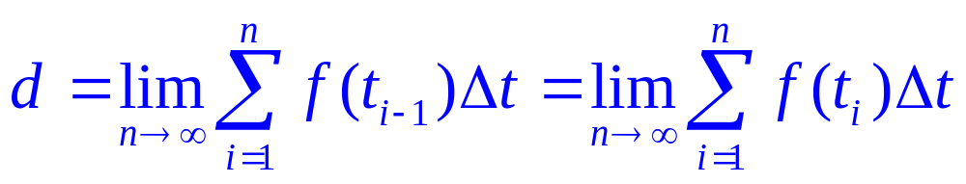
4.1 Approximate Integration and Distance
Distance problem
So, it seems plausible that the exact distance d traveled is the limit of such expressions:
Notes:
Actual distance traveled by approximating the area under the velocity curve.

Slide 27
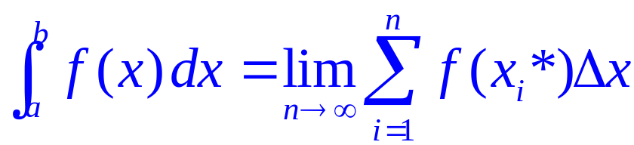
4.2&4.3. The Definite Integral
If f is a function defined for a ≤ x ≤ b,
we divide the interval [a, b] into n subintervals of equal width ∆x = (b – a)/n.
  We let x₀(= a), x₁, x₂, …, x_{n}(= b) be the endpoints of these
  subintervals.
  We let x₁*, x₂*,…., x_{n}* be any sample points in these
  subintervals, so x_{i}* lies in the i ^{th} subinterval.
Then, the definite integral of f from a to b is
provided that this limit exists.
If it does exist, we say f is integrable on [a, b].
The symbol ∫ was introduced by Leibniz and is called an integral sign.

Slide 28
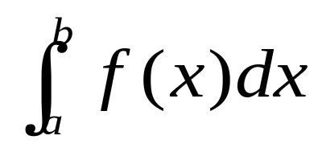
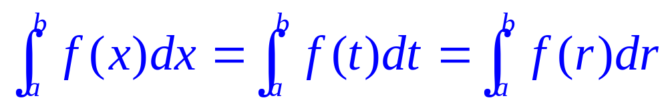

4.2&4.3. The Definite Integral
The definite integral is a number.
It does not depend on x.
In fact, we could use any letter in place of x without changing the value of the integral:
If f is continuous on [a, b], or if f has only a finite number of jump discontinuities, then f is integrable on [a, b].
That is, the definite integral exists.

Slide 29
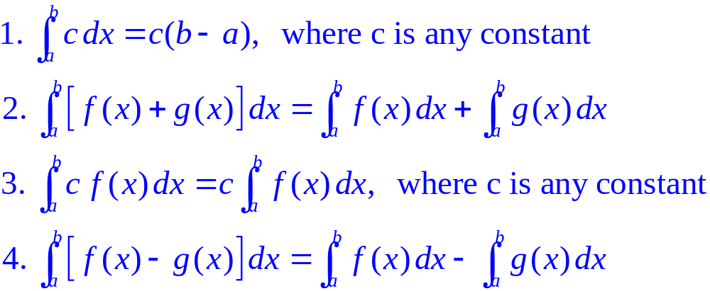
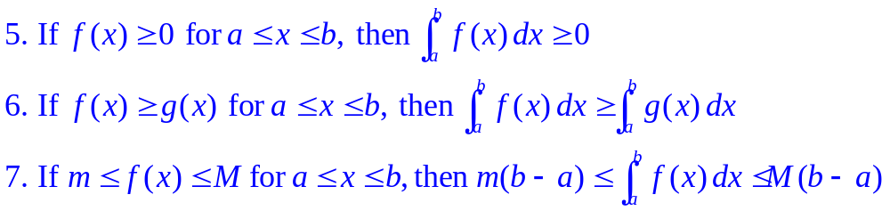
4.2&4.3. The Definite Integral
Properties of the integral
We assume f and g are continuous functions.

Slide 30
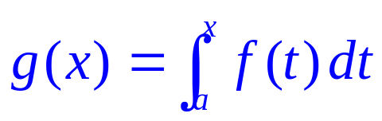
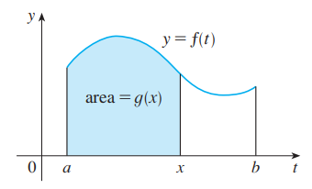

4.4. The Fundamental Theorem of Calculus (FTC)
Theorem FTC 1
The first part of the FTC deals with functions defined by an
equation of the form: where f is a
continuous function on [a, b] and x varies between a and b.
To see why this might be generally
true, we consider a continuous
function f with f(x) ≥ 0.
Then, can be
interpreted as the area under the graph of f from a to x.
Notes:
The right-hand side is a function of x and not t.

Slide 31
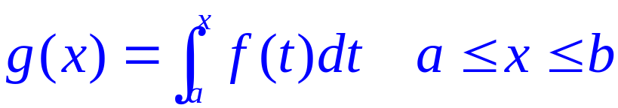
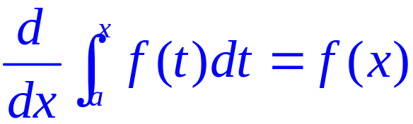
4.4. The Fundamental Theorem of Calculus (FTC)
Theorem FTC1
If f is continuous on [a, b], then the function g defined by
is continuous on [a, b] and
differentiable on (a, b), and g’(x) = f(x).
Using Leibniz notation for derivatives, we can write the
FTC1 as when f is continuous.
Notes:
The right-hand side is a function of x and not t.

Slide 32
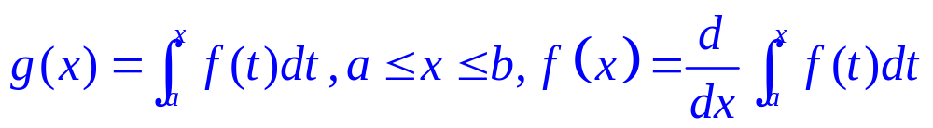
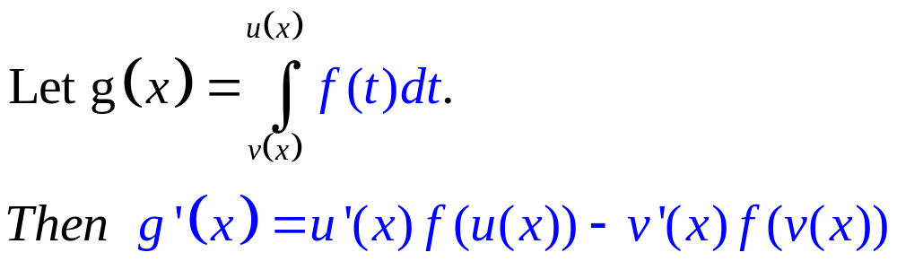

4.4. The Fundamental Theorem of Calculus (FTC)
Theorem FTC1
Generalization
Example: If Find g’(x).
Solution:
Notes:
The right-hand side is a function of x and not t.

Slide 33

4.4. The Fundamental Theorem of Calculus (FTC)
Theorem FTC 2
If f is continuous on [a, b], then
where F is any antiderivative of f, that is, a function such
that F’ = f.
Notes:
The right-hand side is a function of x and not t.

Slide 34



4.4. The Fundamental Theorem of Calculus (FTC)
Net change theorem
So, we can reformulate as follows.
The integral of a rate of change is the net change:
1/ If the mass of a rod measured from the left end to a point x is m(x), then the linear density is ρ(x) = m’(x).
So, is the mass of the segment of
the rod that lies between x = a and x = b.
Notes:
The right-hand side is a function of x and not t.

Slide 35

4.4. The Fundamental Theorem of Calculus (FTC)
Net change theorem
2/ If the rate of growth of a population is dn/dt, then
is the net change in population during
the time period from t₁ to t₂.
  The population increases when births happen and decreases
  when deaths occur.
  The net change takes into account both births and deaths.

Slide 36


4.4. The Fundamental Theorem of Calculus (FTC)
Example:
Suppose that the animal population is increasing at a rate (t measured in years). How much does the animals increase between the third and the seven years ?
Solution
Notes:
Use FTC2

Slide 37

4.4. The Fundamental Theorem of Calculus (FTC)
Net change theorem
3/ If an object moves along a straight line with position function s(t), then its velocity is v(t) = s’(t).
So, is the net change of position,
or displacement, of the particle during the time period
from t₁ to t₂.
If we want to calculate the distance the object travels during that time interval, we have to consider the intervals when:
  v(t) ≥ 0 (the particle moves to the right)
  v(t) ≤ 0 (the particle moves to the left)
Notes:
The right-hand side is a function of x and not t.

Slide 38


4.4. The Fundamental Theorem of Calculus (FTC)
Example:
Suppose the acceleration function and initial velocity are
(m/s²), v(0) = 5 (m/s).
a/ Find the velocity at time t .
b/ Find the distance traveled when
Notes:
Use FTC2

Slide 39




4.4. The Fundamental Theorem of Calculus (FTC)
Solution
a/
So,
b/
Notes:
Use FTC2

Slide 40


4.4. The Fundamental Theorem of Calculus (FTC)
Net change theorem
In both cases, the distance is computed by integrating |v(t)|,
the speed.Therefore,
The figure shows how
both displacement and
distance traveled can
be interpreted in terms
of areas under a
velocity curve.
Notes:
The right-hand side is a function of x and not t.

Slide 41

4.4. The Fundamental Theorem of Calculus (FTC)
Net change theorem
The acceleration of the object is a(t) = v’(t).
So, is the change in velocity from
time t₁ to time t₂.
Example:
A particle moves along a line so that its velocity at time t is:
v(t) = t² – t – 6 (in meters per second).
a/ Find the displacement of the particle during the time period 1 ≤ t ≤ 4.
b/ Find the distance traveled during this time period
1 ≤ t ≤ 4.
Notes:
The right-hand side is a function of x and not t.

Slide 42

4.4. The Fundamental Theorem of Calculus (FTC)
Net change theorem
Solution:
a/ The displacement is:
  This means that the particle moved 4.5 m toward the left.
Notes:
The right-hand side is a function of x and not t.

Slide 43

4.4. The Fundamental Theorem of Calculus (FTC)
Net change theorem
b/ Note that v(t) = t² – t – 6 = (t – 3)(t + 2). Thus, v(t) ≤ 0 on
the interval [1, 3] and v(t) ≥ 0 on [3, 4].
The distance traveled is:
Notes:
The right-hand side is a function of x and not t.

Slide 44

4.4. The Fundamental Theorem of Calculus (FTC)
Mean value theorem
The geometric interpretation of the Mean Value Theorem for Integrals is as follows.
For ‘positive’ functions f,
there is a number c such
that therectangle with base
[a, b] and height f(c) has
the same areaas the region
under the graph of f from a to b.
Notes:
The right-hand side is a function of x and not t.

Slide 45


4.4. The Fundamental Theorem of Calculus (FTC)
Mean value theorem
If f is continuous on [a, b], then there exists a number c in
[a, b] such that
That is,
Example: Fi
Find the average value of the function f(x)=x²+3 on the
interval [2,5].
Notes:
The right-hand side is a function of x and not t.

